Slide 1


Yield-Driven Clock Skew Scheduling Based On Generalized Extreme Value Distribution
Clock skew scheduling is a powerful technique for enhancing the performance and robustness of integrated circuit designs. By adjusting the clock skew to meet the timing constraints of signal paths, designers can improve clock frequency or yield. However, accurately modeling the distribution of path delays under process variations is crucial for effective clock skew scheduling. This paper explores the use of the Generalized Extreme Value (GEV) distribution as a more accurate alternative to the commonly used Gaussian distribution, and presents a yield-driven clock skew scheduling approach based on the GEV model.
by Wai-Shing Luk

Slide 2
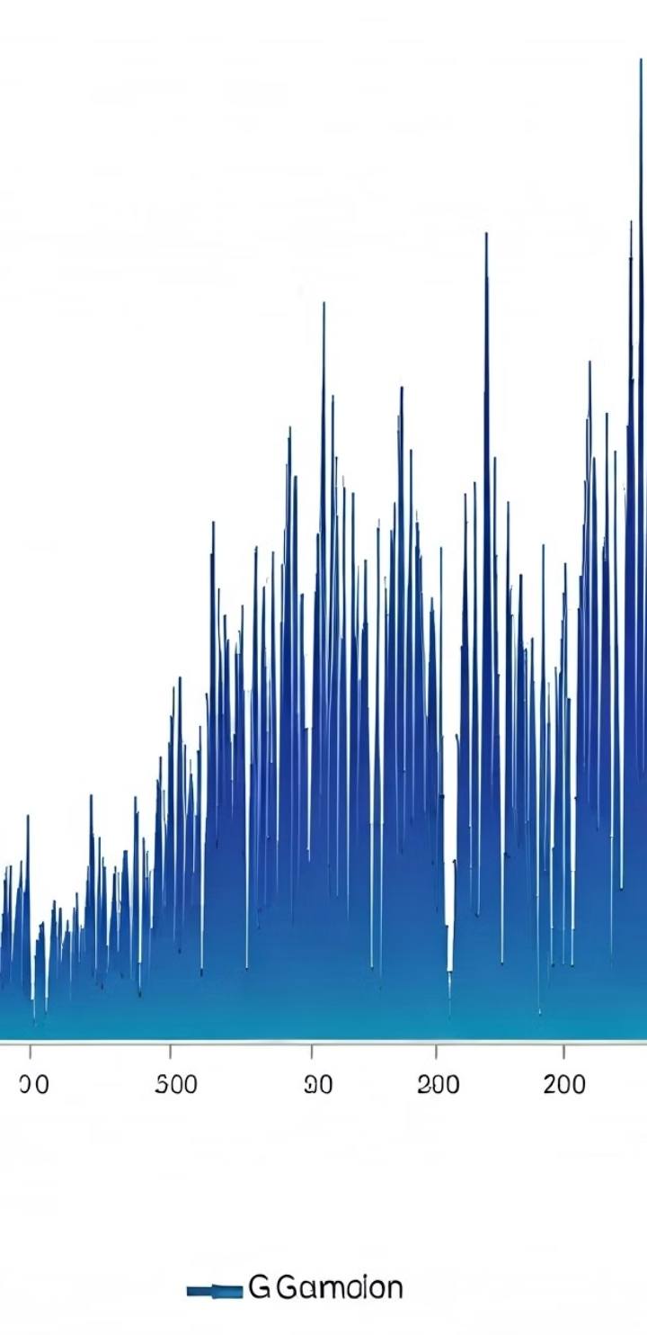
Modeling Path Delays with the GEV Distribution
1
Asymmetric Delays
Studies have shown that the distributions of maximum path delays are often asymmetric and do not follow the symmetric Gaussian distribution.
2
Extreme Value Theory
The Generalized Extreme Value (GEV) distribution, developed in extreme value theory, can better capture the asymmetry and heavy tails observed in actual path delay distributions.
3
Flexible Modeling
The GEV distribution's three parameters (location, scale, and shape) allow it to flexibly simulate a variety of delay distributions, including the Gumbel, Fréchet, and Weibull families.

Slide 3
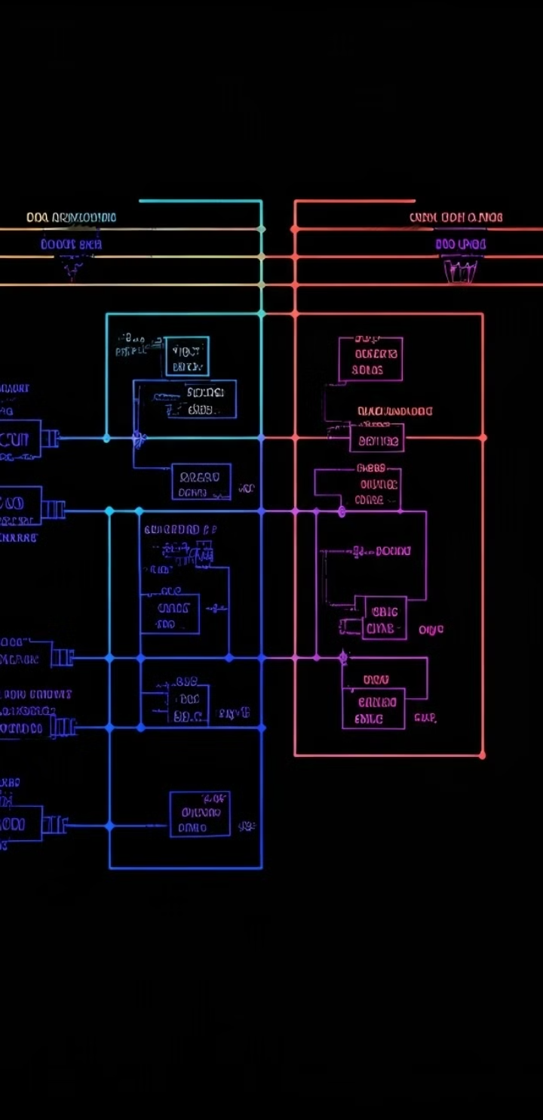
Yield-Driven Clock Skew Scheduling with GEV
1
Formulation
The yield-driven clock skew scheduling problem is formulated to maximize the probability of timing satisfaction, using the quantile function of the GEV distribution to model the path delays.
2
Parameter Estimation
Three parameter estimation methods are evaluated: Maximum Likelihood Estimation (MLE), Linear Moments (L-Moments), and Method of Moments (MoM).
3
Optimization
The optimization problem is solved using numerical methods or binary search, as the GEV model introduces non-linearities that prevent a direct conversion to a linear optimization problem.

Slide 4
Experimental Results
Distribution Fitting
Parameter Estimation
Yield Optimization
The GEV distribution demonstrates a 40% lower Kolmogorov-Smirnov (KS) statistic and an 8% lower Root Mean Square Error (RMSE) compared to the Gaussian distribution, indicating a better fit to the SSTA results.
Among the three estimation methods, Maximum Likelihood Estimation (MLE) shows the lowest RMSE, making it the most effective in capturing the statistical characteristics of the timing data.
The yield-driven clock skew scheduling based on the GEV distribution achieves up to 33.3% and on average 8.1% improvement in timing yield compared to the Gaussian-based approach.

Slide 5

Conclusion
Improved Modeling
Yield Optimization
Flexible Approach
The GEV distribution can more accurately model the asymmetric and heavy-tailed distributions of path delays, outperforming the commonly used Gaussian distribution.
Yield-driven clock skew scheduling based on the GEV distribution demonstrates superior timing yield outcomes compared to the Gaussian-based approach.
The proposed framework can accommodate various parameter estimation methods, allowing for a tailored solution to the specific characteristics of the circuit under consideration.

Slide 6




Limitations and Future Work
Diverse Distributions
The current approach assumes a single distribution type (GEV) for all path delays, which may not be appropriate in all cases.
Optimization Complexity
The non-linear nature of the GEV distribution makes the optimization problem more challenging, requiring numerical methods or binary search.
Future Directions
Exploring more flexible optimization frameworks that can handle multiple delay distribution types could further improve the effectiveness of yield-driven clock skew scheduling.

Slide 7

Key Takeaways
1
Asymmetric Delays
Path delays often exhibit asymmetric and heavy-tailed distributions, which cannot be accurately captured by the commonly used Gaussian model.
2
GEV Distribution
The Generalized Extreme Value (GEV) distribution can better fit the actual delay distributions, with its flexible parameters allowing for a variety of skewness and tail behaviors.
3
Yield Optimization
Yield-driven clock skew scheduling based on the GEV distribution can achieve up to 33.3% improvement in timing yield compared to the Gaussian-based approach.

Slide 8

Potential Applications
High-Performance Computing
Optimizing clock skew in high-performance computing systems can lead to significant improvements in clock frequency and overall system performance.
Low-Power Electronics
Careful clock skew management can also help reduce power consumption in low-power electronic devices, such as mobile phones and wearables.
Safety-Critical Systems
The reliability-aware clock skew scheduling techniques can be particularly valuable in safety-critical applications, where timing failures can have severe consequences.

Slide 9




Future Research Directions
Multimodal Distributions
Correlated Delays
Adaptive Scheduling
Investigating methods to handle multimodal delay distributions, which may arise from complex manufacturing processes or circuit topologies.
Developing techniques to incorporate the correlation between path delays, which can further improve the accuracy of the optimization.
Exploring dynamic, adaptive clock skew scheduling approaches that can adjust to changing operating conditions or manufacturing variations over time.

Slide 10

Acknowledgments
The authors would like to acknowledge the support and contributions of the research community in the field of clock skew scheduling and statistical timing analysis. This work was partially funded by [funding source] and benefited from the insights and feedback provided by [collaborators].

Slide 11
🙋 Q & A

